Slide 1
TASK 1
PORTSWIGGER LABS

Slide 2
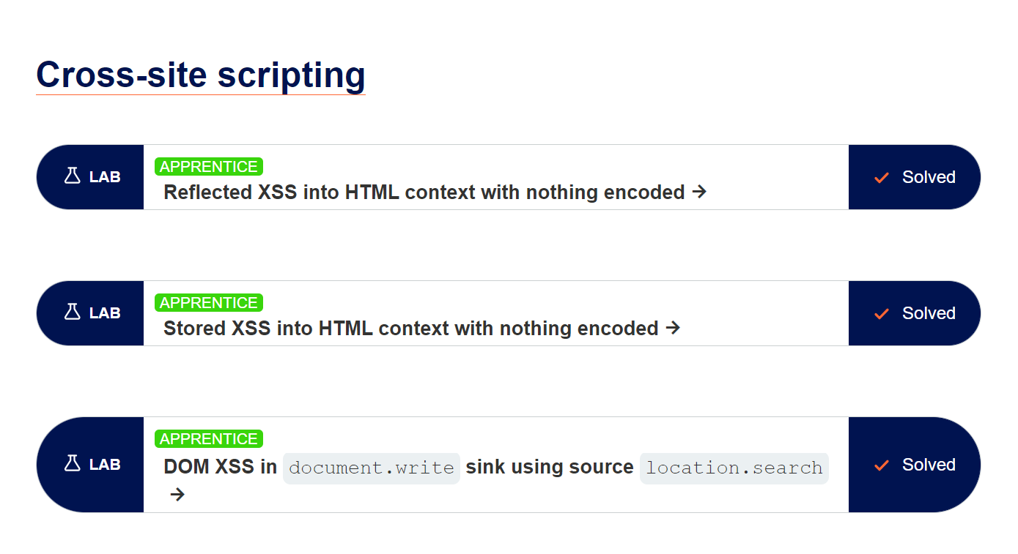

Slide 3
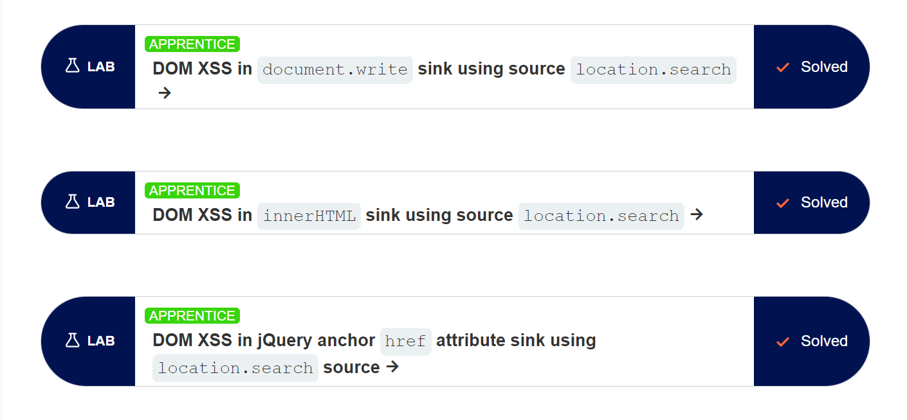

Slide 4
THANK YOU

